Slide 1
Weekly report: Feedback & Lidar – Assisted Controller
Week number: 10
Date: 02/12/2025
Supervisor: Prof. Dr.-Ing. David Schlipf
Group members: Mirza Dincer, Saurabh Pankaj Jha, Midhun Kanichattu Venu
Presenter: Mirza Dincer

Slide 2
List of Contents
Tasks of the week
Torque Controller for Optimus
Lidar Measurement Distance
Conclusion
Mirza Dincer

Slide 3
Tasks of the Week
Torque controller for Optimus.
Determining lidar measurement distance.
Mirza Dincer

Slide 4
Torque Controller for Optimus Syria​
Starting Kp same as IEA 3.4 MW, Values similar to IEA 3.4 MW for Optimus Syria
Assuming Ki = Kp/Ti, Ti equals to 1P time
PI controller of torque controller only on the region 1.5 and region 2.5.
In region 2, we need to have constant TSR, for Optimus it is 8.5.
Mirza Dincer

Slide 5
Updated Torque Controller
Region 1.5: Transition to region 2, PI controller is used for low loads and increased energy.
Region 2: Between 800 and 1200 rpm controller keeps the TSR constant, to stay at optimal Cp.
Region 2.5: Transition to region 3, PI controller is used for low loads and increased energy. Also transition to pitch controller.
[1]
Figure 1: Torque controller for Optimus Syria
Mirza Dincer

Slide 6
Lidar Measurement Distance
The measuring distances of lidar for 70, 90,110, 130, 150, 160 meter with four beampulsed lidar is checked for IEA 3.4 MW.​
The smallest detectable eddy size (SDES) is a measure preview quality. It is the coherence bandwidth (k at coherence=0.5) normalized by rotor diameter: 1D is very good and 3D is sufficient. IEA 3.4 MW turbine has a rotor diameter D = 130 m.​
A small SDES is needed, which shows higher correlation between rotor effective speed that is measured from wind turbine and rotor effective speed that is calculated from lidar measurement.​
[1]
Mirza Dincer

Slide 7
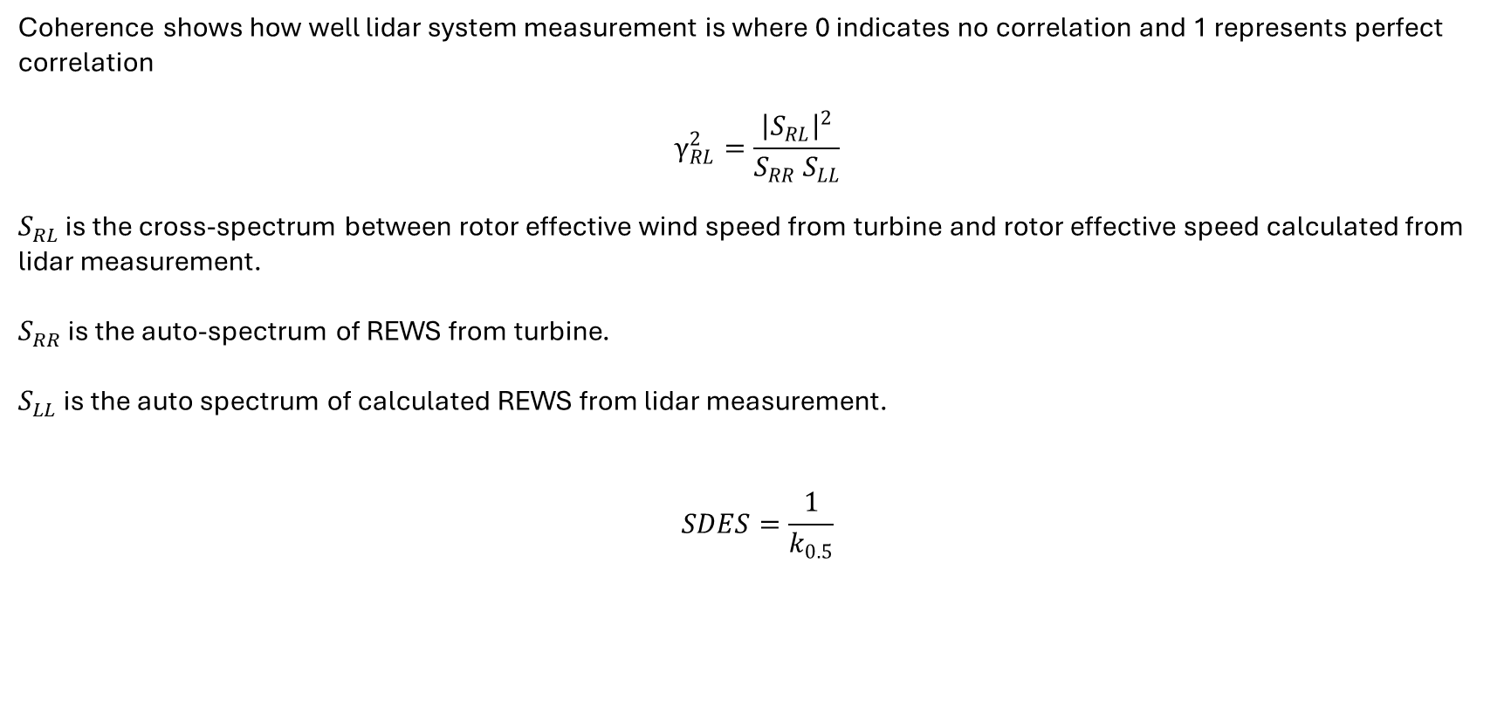
How to optimize the distance for SDES?​
Coherence shows how well lidar system measurement is where 0 indicates no correlation and 1 represents perfect correlation
$$γ_{RL}^{2}=\frac{{\left|S_{RL}\right|}^{2}}{S_{RR} S_{LL}}$$
$S_{RL}$ is the cross-spectrum between rotor effective wind speed from turbine and rotor effective speed calculated from lidar measurement.
$S_{RR}$ is the auto-spectrum of REWS from turbine.
$S_{LL}$ is the auto spectrum of calculated REWS from lidar measurement.
$$SDES=\frac{1}{k_{0.5}}$$
[1]
Mirza Dincer

Slide 8
How to optimize the distance for SDES?​
Figure 2: Coherence for 4 beam pulsed lidar measured at 90 meter
Mirza Dincer

Slide 9
Lidar Measurement Distance
Figure 2: Coherence Bandwidth and SDES comparison between different measurement distances.
Mirza Dincer

Slide 10
Lidar-Assisted Control Simulations​
660 seconds of simulation. Evaluation of values starts at t = 60 second to get settled values. Additionally, wind wraps around.
DLC 1.2 wind fields with average 20 m/s
Enabled all DOFs.
Initial conditions of pitch angle, rotor speed and fore-aft tower position for every corresponding wind speed.
Running both feedback controller and lidar-assisted controller.
First try: no filter, so uncorrelated frequencies are still used.​
Mirza Dincer

Slide 11
Lidar-Assisted Control Simulations​
Figure 3: Comparison of feedback only and feedback-feedforward controller under turbulent wind
Mirza Dincer

Slide 12
Lidar-Assisted Control Simulations​
Decrease of power spectrum in high frequency shows that there is less fluctuation in rotor speed in shorter times.
Still unnecessary higher frequencies
Figure 4: Power spectral density of rotor speed comparison between feedback only and feedback-feedforward
Mirza Dincer

Slide 13
Conclusion
For IEA 3.4 MW, it looks like 90-meter measurement is the optimal point with smallest detectable eddy size and highest measurement coherence bandwith.
REWS needs to be filtered by low pass filter which will help reduce the noises in pitch angle signal.
We learned how should we determine measurement distance of lidar.
Next weeks:
Start to prepare control files for OpenFAST and provide to the Loads and Dynamics team. We need to stay updated and speed up.
Calculate cut-off frequency for low pass filter of feedforward pitch.
Check the rotor speed and tower base bending moment spectra again for 6 seeds of 20 m/s, and if it fits the theory.
Mirza Dincer

Slide 14
Biblography
[1] D. Schlipf, "Lidar-Assisted Control for Wind Turbines I," Class Lecture, Topic: "Controller Design for Wind Turbines and Wind Farms," Wind Energy Engineering Master, Hochschule Flensburg, Flensburg, Germany, [17/11/2025].
Mirza Dincer

